Slide 1

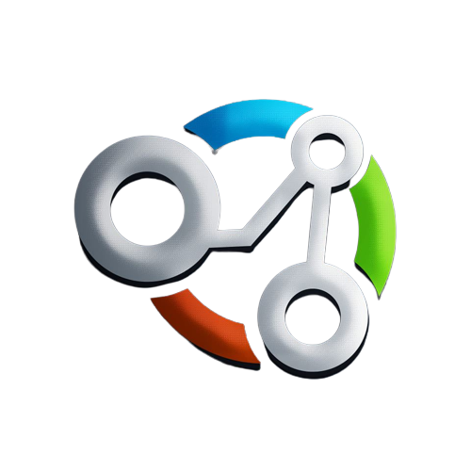
Python and utility libraries
Hossam Ahmed Salah

Slide 2



Agenda
Why Python for AI and ML?
Alternatives
NumPy
Pandas
Matplotlib
CODE

Slide 3

Why Python for AI and ML?

Slide 4
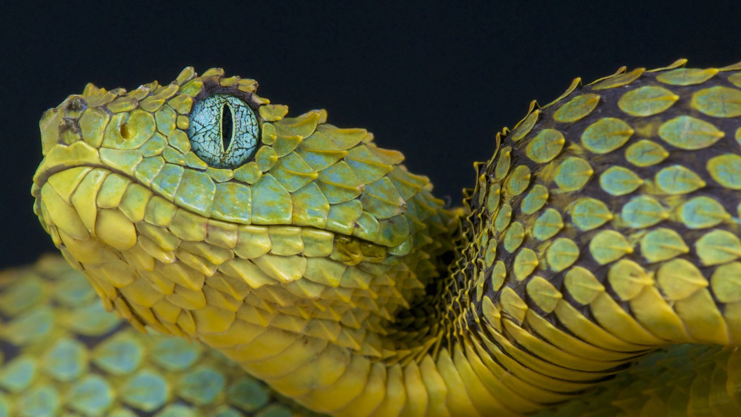
Python easy to use ‘’ doesn’t byte ‘’
Python has a simple syntax that is easy to learn
It is accessible to both beginners and experienced programmers.
Developers can quickly learn Python and focus on solving AI and ML problems rather than language details.

Slide 5
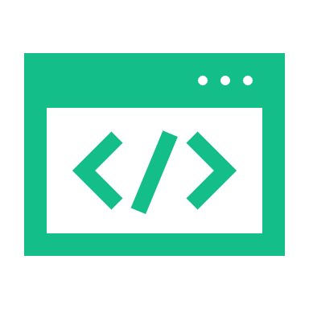
A great library ecosystem
Python has libraries for AI and ML, like NumPy, Pandas, Scikit-learn, TensorFlow, and PyTorch.
The libraries offer data processing, analysis, machine learning algorithms, and deep learning frameworks.

Slide 6

Large and Active Community
Python community has active members in AI and ML fields.
Developers benefit from a variety of libraries and frameworks.
Access to numerous tools and resources for quick and efficient AI/ML app development and deployment.

Slide 7
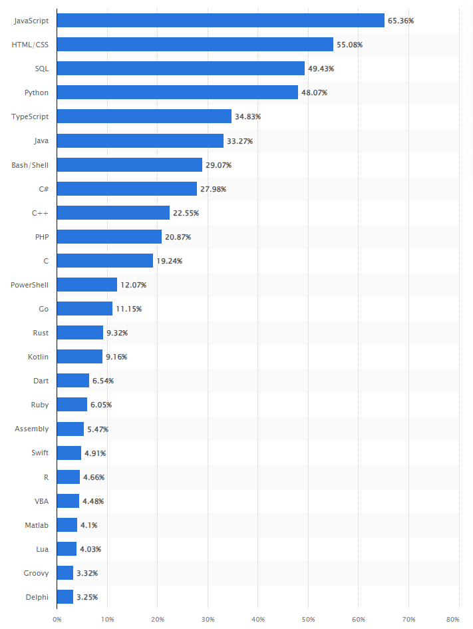
Most used programming languages among developers worldwide as of 2022

Slide 8
Variety of applications
Python is versatile and used in multiple domains
Python is commonly used for web development, scientific computing, data analysis, machine learning, AI, automation, scripting, and software development
It is also utilized in network programming, game development, natural language processing, and data visualization

Slide 9
Alternatives

Slide 10
Alternatives
R
Java
C++
JavaScript

Slide 11
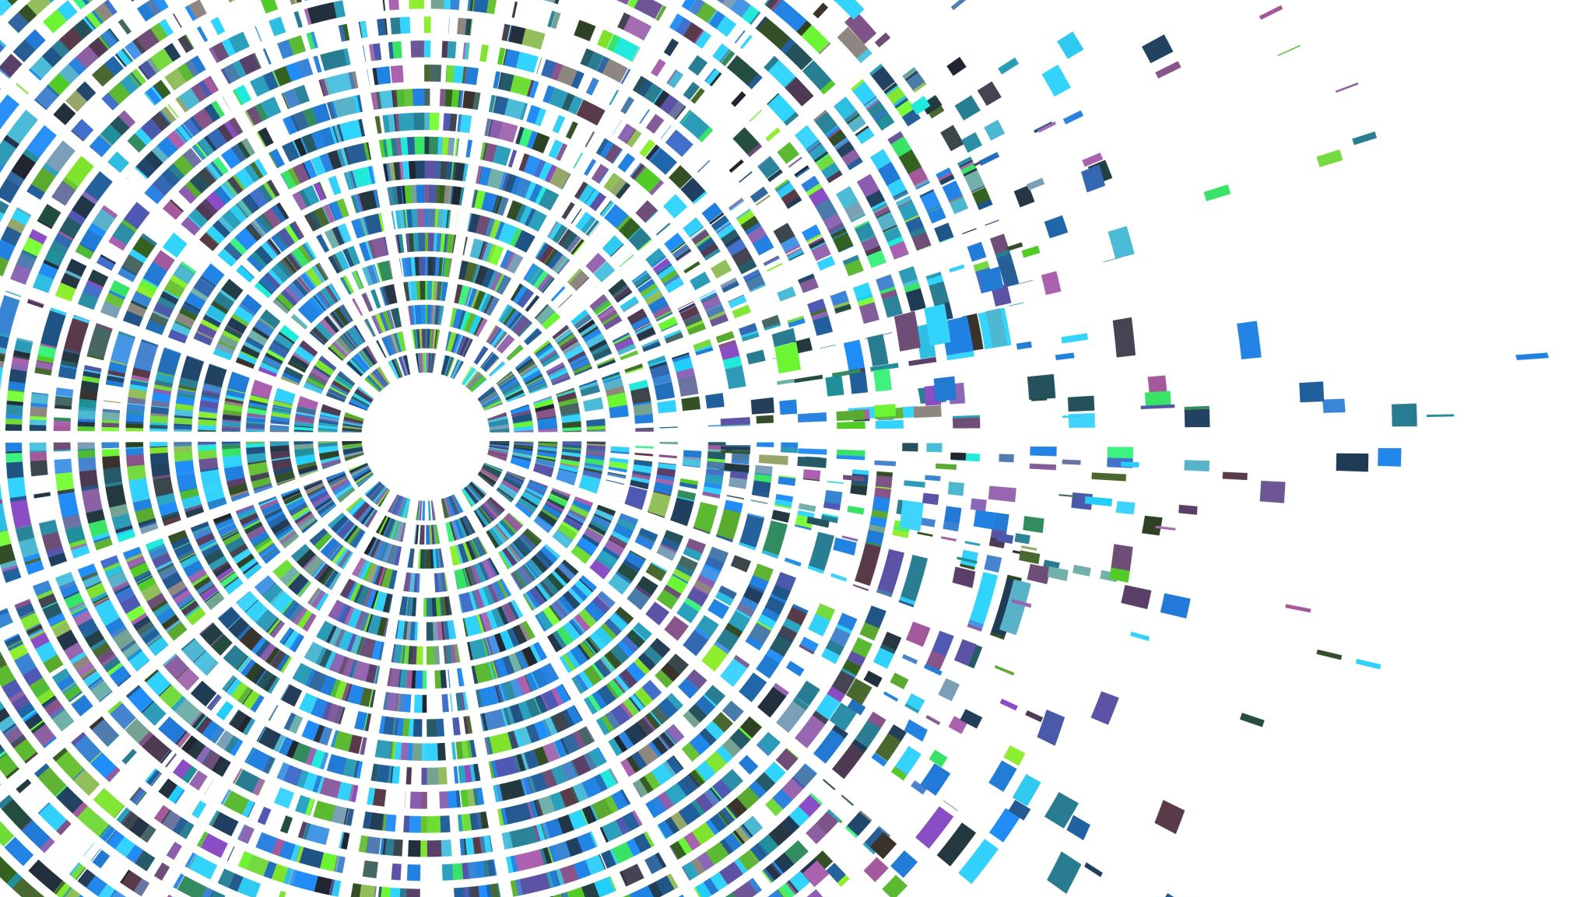
NumPy

Slide 12
NumPy is a Python library for scientific computing and data analysis.
It supports large, multi-dimensional arrays and matrices.
NumPy is implemented in C, making it faster than pure Python code for numerical computations.
It offers features like linear algebra, Fourier transforms, and random number generation.
The ndarray object in NumPy allows manipulation of homogeneous multidimensional data.
NumPy is widely used in scientific computing, data analysis, machine learning, and various scientific and engineering applications.

Slide 13

Pandas

Slide 14
Pandas is an open-source Python library for data manipulation, analysis, and visualization.
The main data structure in Pandas is the DataFrame, a two-dimensional table-like structure.
Pandas offers powerful tools for data cleaning and preparation.
Pandas supports data visualization through built-in functions and integration with libraries like Matplotlib.
It is built on top of NumPy for efficient numerical operations and works well with other Python libraries like Scikit-learn.
It can handle missing data, reshape and merge datasets, and perform statistical and time series analysis.

Slide 15
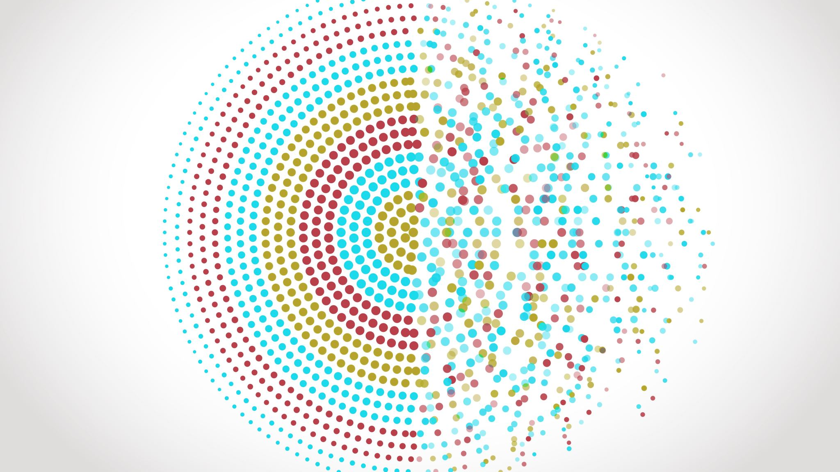
Matplotlib

Slide 16
Matplotlib is an open-source Python library for visualizations. It offers various tools for creating static, animated, and interactive visualizations.
Matplotlib is built on top of NumPy for efficient data manipulation.
It supports line plots, scatter plots, bar plots, histograms, heatmaps, and more.
Users can customize and fine-tune every aspect of the visualization
It supports multiple output formats like PNG, PDF, SVG, EPS, etc.
Matplotlib is widely used in data visualization, scientific computing, and machine learning.
It is a fundamental library in the Python data science ecosystem.

Slide 17

Code

Slide 18
References
https://www.statista.com/statistics/793628/worldwide-developer-survey-most-used-languages/

